Slide 1
PRACTICE SCHOOL - 1
MID Semester Presentation
Business Insights Dashboard using Power BI
SUYASH MANGLA (2023A70593P)

Slide 2
Company & Project
IIC (INK IN CAPS) is a Mumbai-based full-service MarTech agency specializing in designing scalable experiential marketing campaigns.
The company leverages cutting-edge technologies such as Artificial Intelligence, Interactive Media, Augmented Reality (AR), Virtual Reality (VR) and Content Development to help brands deliver immersive and engaging experiences.
I am working on a Business Insights Dashboard project at IIC Interactive Labs, under the mentorship of Ms. Divya Jain, where we utilize Power BI to analyze company performance data and deliver interactive, data-driven visualizations.
Currently transitioning to Google Data Studio (Looker Studio) to explore data visualization

Slide 3
My Learnings
Gained practical experience in data modeling, including creating relationships between tables using primary and foreign keys.
Learned to clean, transform, and shape data using Power Query Editor for accurate and consistent analysis.
Used DAX (Data Analysis Expressions) to create calculated columns, measures, and custom KPIs.
Designed interactive dashboards using various visuals like bar charts, line charts, donut charts, and maps.
Implemented slicers, filters, and tooltips to enhance dashboard interactivity and user experience.
Practiced color coding, layout formatting, and theme consistency for professional dashboard presentation.

Slide 4
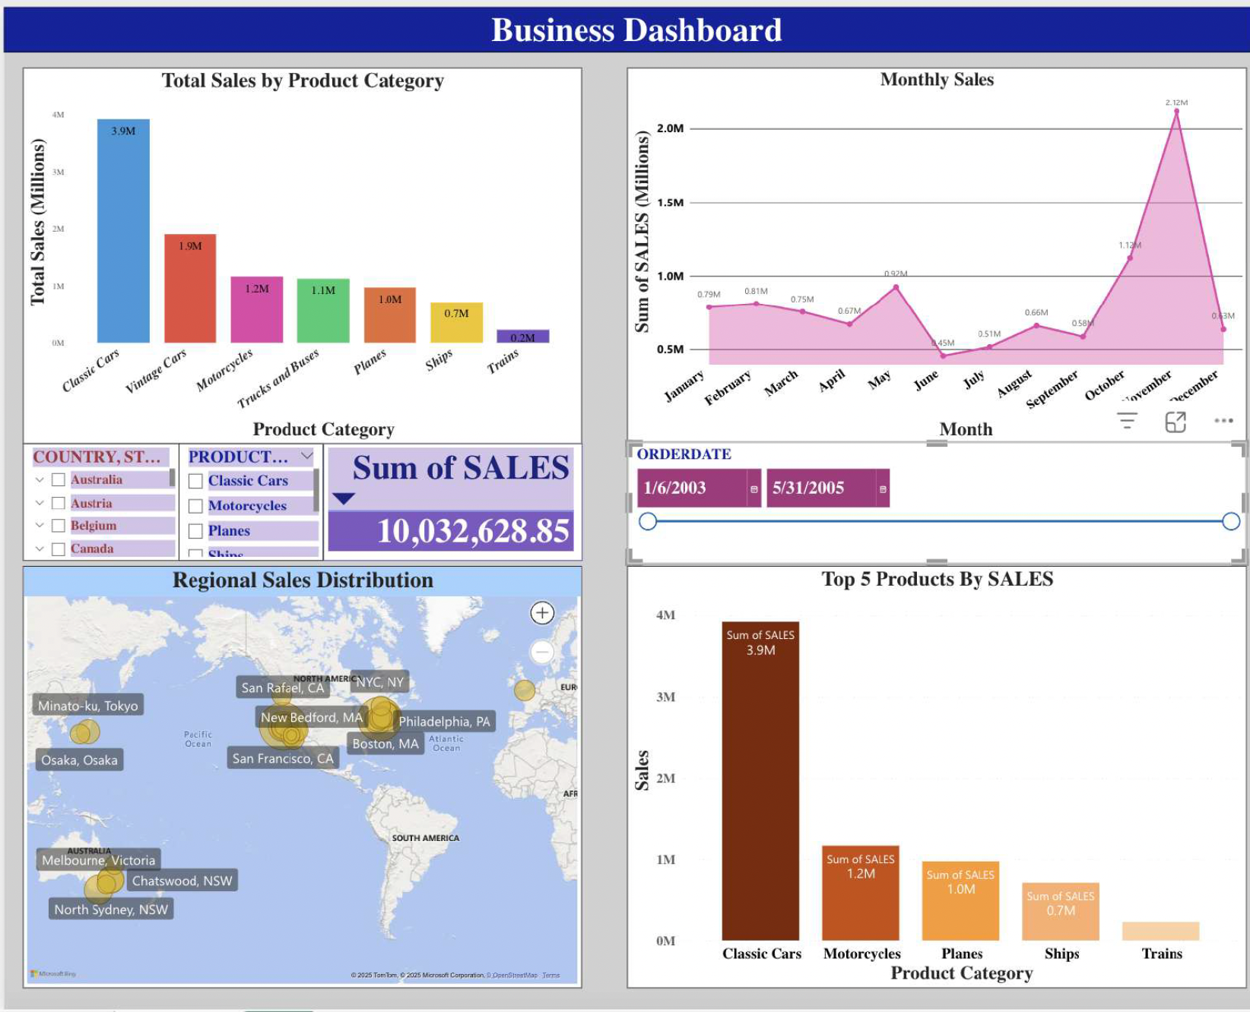
Business Dashboards - 1
Key Visuals & Insights:
Classic Cars are the top-selling product with $3.9M in sales, followed by Vintage Cars and Motorcycles.
Peak observed in November with sales touching $2.2M; lowest in June and July.
High sales observed in cities like New York, San Francisco and Tokyo.
Slicers for filtering by Country, Product, and Date Range for dynamic insights.

Slide 5
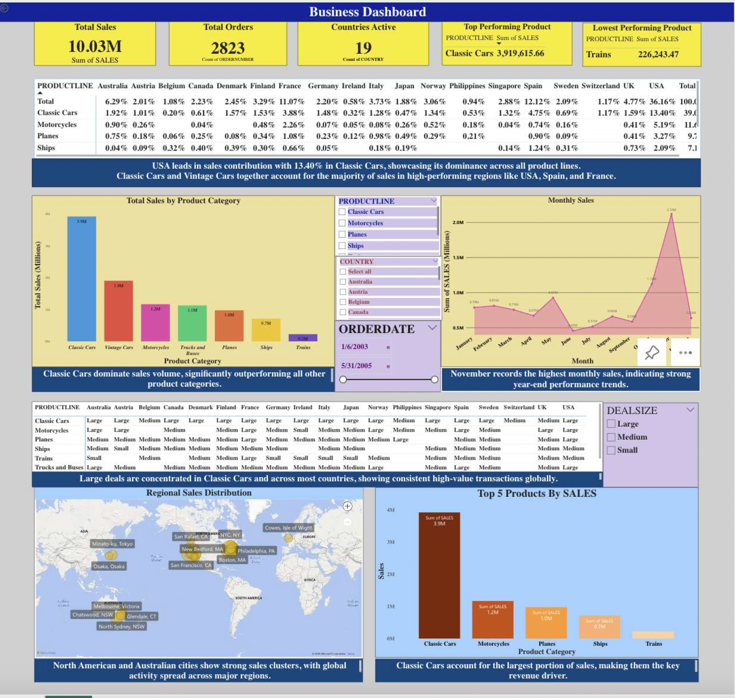
Business Dashboards - 2
Adding new features:
Smaller categories like trains and ships may need performance evaluation or repositioning.
Large deal sizes are consistently observed in classic cars across almost all countries, underscoring their role in driving not just volume but also high-value transactions.

Slide 6
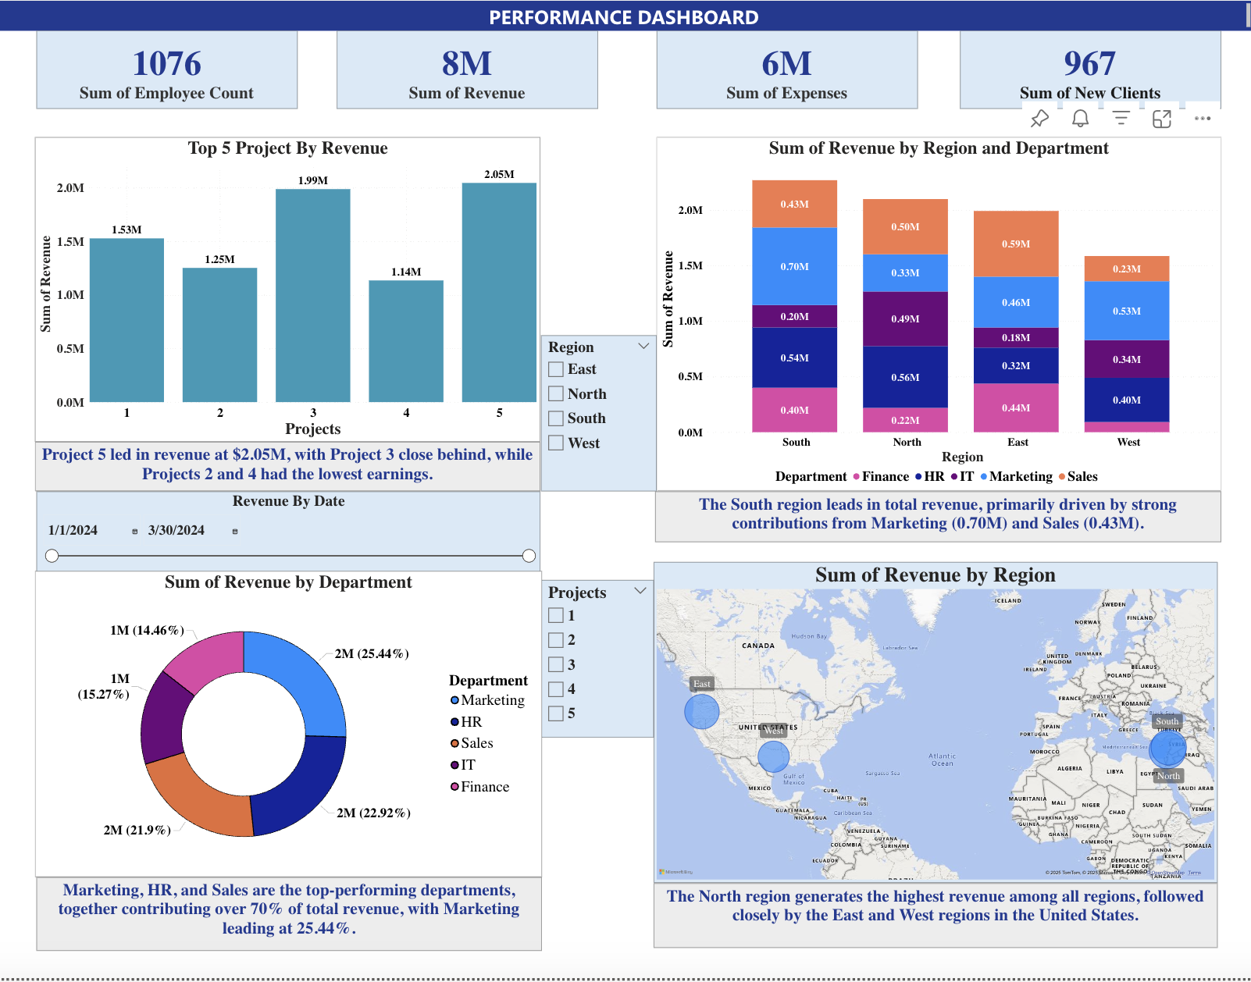
Performance Dashboard
The company has generated a total of $8M in revenue, with 6M in expenses, and a total workforce of 1,076 employees.
967 new clients have been onboarded, indicating steady business growth.
Project 5 leads in revenue at $2.05M, followed closely by Project 3 ($1.99M).
Projects 2 and 4 have the lowest revenue, suggesting potential areas for review or optimization.

Slide 7
Conclusion
I successfully created three interactive dashboards using the web version of Power BI, focusing on visualizing key performance metrics such as revenue, departmental performance, regional distribution, and project-based analysis.
These dashboards enabled insightful business decisions through clean design, filters, and tooltips.
Currently, I have transitioned to Google Data Studio, where I’m building a comprehensive marketing dashboard aimed at providing actionable insights to the marketing leadership team.

Slide 8
THANK YOU!

